Slide 1


Accelerated Open Source vBRAS Solution Based on OpenBRAS and VPP/DPDK
Hongjun Ni & Liang Ou, Yujia Luo
Intel China Telecom
Acknowledgement:
Heqing Zhu, John DiGiglio, Beilei Xing @Intel
Neale Ranns @Cisco

Slide 2
Agenda
BRAS in China Telecom
OpenBRAS Architecture
vBRAS Deployment
Data Plane implementation
Distribute traffic using NIC
Key Takeaway

Slide 3



BRAS in China Telecom
What is BRAS？Broadband Remote Access Server
authenticate, authorize and route broadband subscriber data traffic according to customized policies
AAA
V
-
NET
ITSupport
Chinanet
Chinanet (100 million BroadBand subscribers)
System
IP Backbone for Internet Service
150 cluster routers，2000 link
MAN interconnect，traffic aggregation
300 MANs，Capacity over 30T
Over 10K BRAS hardware devices
MAN
MAN
MAN
IDC
Enterprise
IP Network of China Telecom
Biggest IP backbone in the world
Notes:
Hello, everyone, I’m Yujia LUO from China Telecom. It’s my honor to share something about our open source vbras based on vpp.
First let me introduce BRAS, which is short for broadband remote access server. Basically it’s a network device used to authenticate, authorize and route subscribers’ data traffic.
The location of bras can be found in this picture, between the access network and metropolitan network, where we called central office. There are over 10 thousand bras in China telecom network and we hold the most biggest IP backbone in the world.

Slide 4
Traditional BRAS Architecture
BRAS
DHCP
Server
Radius Server
=
BRAS
Router
+
IP address
Mgnt
User
Mgnt
Routing
(BGP/IGP)
Radius
Access Management
Session Mgnt
TCP/IP
Drawbacks:
1. Control Plane and Forwarding Plane are tightly coupled
2. Not flexible to scale
PPP
IPOE/DHCP
PPPoE
Forwarding Engine
Notes:
Before NFV is introduced, the traditional bras is a hardware device that merge router and access management functions together.
But the drawbacks are quite obvious. The control plane and forwarding plane are tightly coupled, which makes it slow or difficult to do any single change. It’s not efficient and inconvenient.

Slide 5

vBRAS Architecture
www.openbras.org.cn
v
vDHCP
vAAA
Microservice Bus
OpenBRAS Control Plane
MANO
Session discovery service
Data plane control service
Common service
NFV-O
vBRAS based on rack
IPoE
PPP
Subscriber
Routing
ACE
GVNFM
PPPoE
L2TP
ACL
QoS
libevent
Cloud Management
Southbound
Plugins
OpenStack
Kubernetes
Openflow
NETCONF
RESTCONF
OpenBRAS Data Plane
Slow Path
Supported Data Plane Options
Control Plane Agent
Socket
Legend
Classifier
Decap
ACL
Policer
Routing
DPDK
VPP
Control plane
Uplink
HQoS
Encap
Routing
Commercial Software
SmartNIC
Data plane
Downlink
ACL
Notes:
So NFV try to solve the problem by seperating the software from hardware.
BRAS is virtualized into an app which is called vbras and is installed on servers.
What is more, the router function and access management function of bras are seperated too.
The access management function becomes control plane, and Router becomes data plane.
The control plane includes session discovery service, data plane control service, common service and southbound plugins. China Telecom uses PPPoE or IPoE protocol during session discovery process.
The data plane supports various options like VPP, DPDK, smart nic and so on to accelerate the forwarding process.
This architecture of vbras actually comes from the OpenBRAS project, which is an open source project founded by china telecom, intel, inspur, mellanox and many other partners. I will talk about this later.

Slide 6

PPPoE/IPoE Processing of vBRAS
OpenBRAS Control Plane
Session discovery service
Data plane control service
IPoE
PPP
Subscriber
Routing
PPPoE
L2TP
ACL
QoS
Southbound
Plugins
Openflow
NETCONF
RESTCONF
VxLAN
NETCONF
OpenBRAS Data Plane
Session Table
User MAC | Session ID | User IP address | Access Protocol
VPP-Classifier
Forwarding table
VPP
Dst IP address | Action
Port0
Port1
PPPoE/IPoE
Access Port
Uplink Port
IP forwarding
Notes:
This page shows a specific case we’d like to share. We utilized vpp to realize the offloading of PPPoE/IPoE processing.
Previously, all the flow will be sent to control plane which keeps CPU very busy. May jobs have to stay inline and wait for CPU, which is slow.
So we decided to move some of the jobs from control plane to data plane. After offloading, VPP can help to classify the flow, and some of the flow can be forwarded to uplink port directly.

Slide 7
What does VPP need to do?
Identify PPPoE Discovery and Session packets
With eth_type 0x8863 and 0x8864
Identify PPP Packets with ppp_protocol 0x0021
Which are identified as IP packets
Identify DHCP Packets with (udp_src_port, udp_dst_port) = (67, 68) or (68, 67)
Identify Routing Packets (BGP/IGP)
Encap or Decap PPPoE and PPP packet
Forward packets between access port and uplink port
Look up table
Session table to determine whether the traffic is allowed to forward
Forwarding table to determine which port to forward the traffic
Notes:
Here is what VPP needs to do. Basically there are 3 kinds of jobs.
The first one is to identify packets, some of the packets are directed to the control plane, and some are forwarded directly.
The second is to encapsulate and decapsulate the packet.
The last thing is to look up the tables. There are 2 kinds of table.
Session table determines whether the flow is legal or not.
Forwarding table determines which port to forward the traffic.

Slide 8
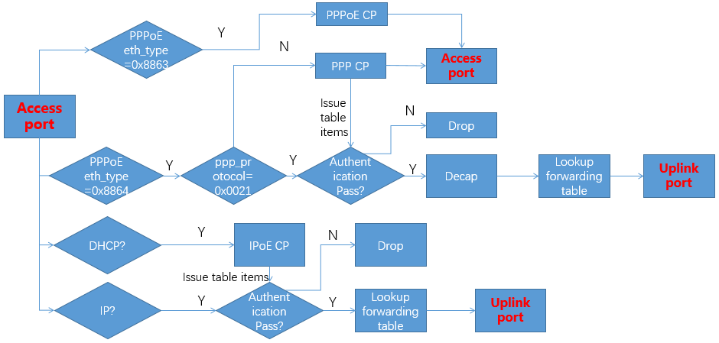
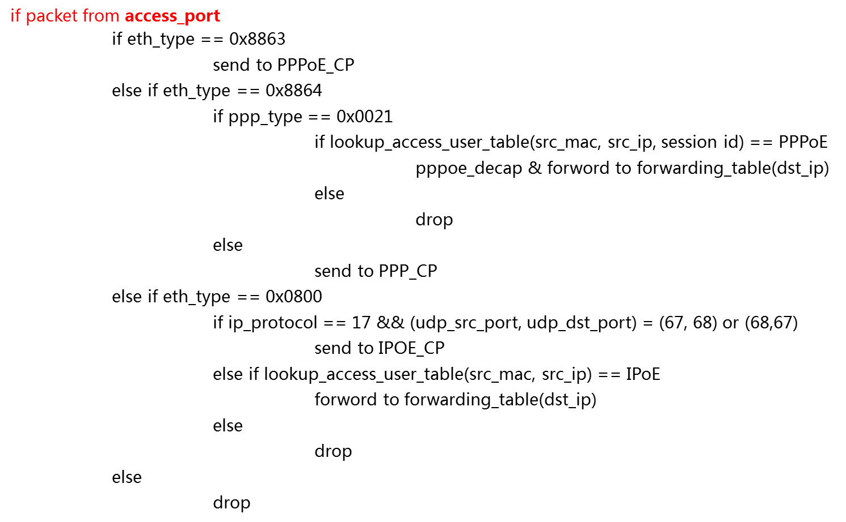
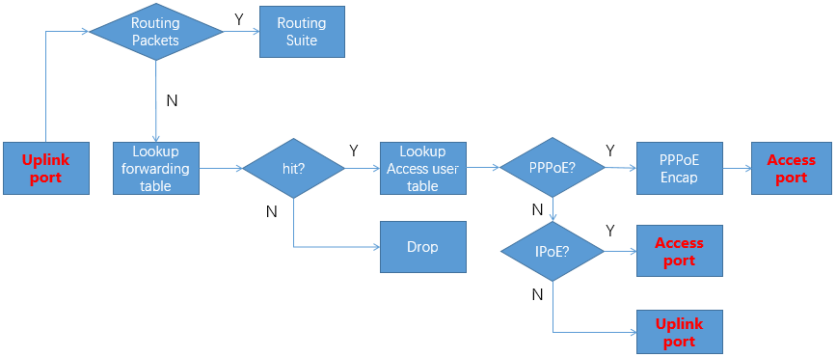
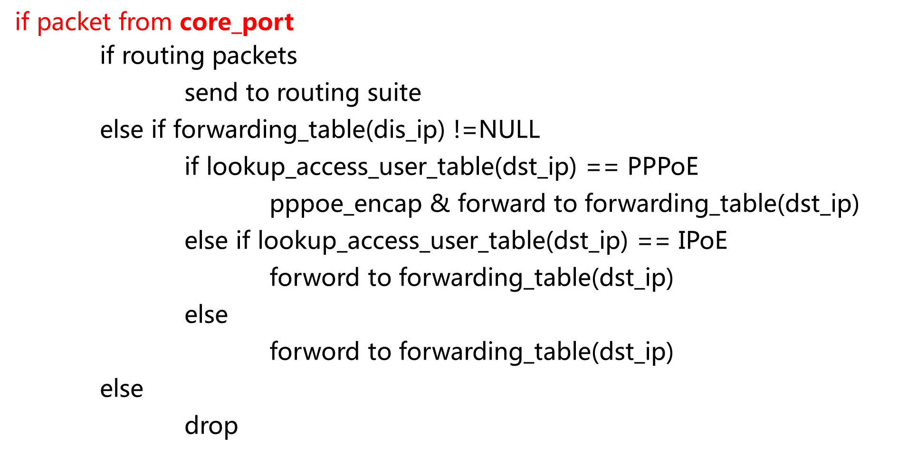
vBRAS Processing Flow and Pseudo Code
Notes:
This page shows the detail logic of vbras processing, which I’m not going deep into it.

Slide 9



Where does vBRAS locate in China Telecom ?
Pub App
Ents App
3rd App
API
API
Open API
SDN/NFV Network Orchestrator
GS-O
Orchestration
Layer
OSS/BSS
NFV-O
SDN-O
SDN Controller
VNFM
Network Control
Layer
EMS/NMS
Access
Controller
IP Metro
Controller
Transport
Controller
DC
Ctrl
VIM
PIM
NFVI ctrl
Edge Cloud
Core Cloud
vBRAS
vIMS
Infrastructure
Layer
NFVI
NFVI
5G
Access
IP
4G
Optical
2G/3G
Notes:
When talking about the deployment of vbras, we all agree that vBRAS should be put in NFV environment together with VIM, VNFM, controller and orchectrator.
This is a big move from our traditional architecture, and many work have to be done. The industry had already paid attention on this area, and the most famous case is the CORD project. I think everybody knows that.
China telecom shares the same idea. We are trying to re-architect the old framework. In case of the infrastructure layer, we plan to divide it into 2 parts, the edge cloud and the core cloud, and vBRAS mainly located in edge cloud.

Slide 10
Possible Deployment of vBRAS
Edge Cloud
Core Cloud
vBRAS-CP
vBRAS-CP
vBRAS-UP
Internet
Subscriber
PON
vBRAS-UP
CR
Subscriber
PON
Traditional
BRAS
PPPoE/IPoE
IPTV
VoIP
ITMS
Notes:
We believe that the traditional bras and vbras will coexist for a very long time.
The possible deployment solution of vbras is shown in the picture. The data plane locates in edge cloud because it’s close to the user. The location of control plane varies according to the service.
For example, service like IPTV and surfing the Internet create tremendous traffic flow, so we suggest the control plane should be located in the same cloud as the data plane. But for service like VoIP and ITMS, the control plane could be centralized in core cloud.

Slide 11




OpenBRAS Promotes vBRAS Deployment
Project: Dedicated to build an open source vBRAS system, providing reference design
www.openbras.org.cn
vBRAS CO Deployment Reference Solution
Redesign CO based on NFVI, considering room area, floor bearing, power supply, cooling system
Provide some typical device specifications
China Telecom vBRAS Technical white Paper
Include industry trends, key elements, use cases, and solutions of vBRAS
vBRAS offloading Solution
vBRAS offloading solution based on Smart NIC
Smart NIC: jobs like PPPoE/PPP En/Decap, traffic forwarding
Notes:
As I mentioned before, openBRAS is a project aiming at promoting vBRAS deployment.
It is dedicated to build an open source vBRAS system and to provide reference design.
Developers will find white papers, solutions, source codes of reference design and tools on our official site.
Last year, we published China Telecom vBRAS Technical White Paper, which includes industry trends, key points of vBRAS, use cases, and solutions.
In order to enhance the performance of vBRAS data plane, we presented vBRAS offloading solution based on vpp and smart nic.
In addtion, China Telecom also focus on NFV infrastructure of Central office. We had done a lot of NFV decoupling test and met some problems. Form of hardware varies, and there is no unified way to configure and obtain the information.
The process of deploying, installing, integrating are repeated and error-prone.
What’s more, conditions like room area, floor bearing, power supply, cooling system are not always satisfying.
So together with our partners, we came up with the solution of all-in-one delivery, which can be found on our website too.

Slide 12
Upstream Processing
OpenBRAS
(PPPoE/PPP handshaking)
Dataplane
PPPoE
PPP
Radius
DHCP
Control Plane
VPP-based BRAS
ETH
PPPoE
IP
ETH
IP
Upstream Worker 0 - N
NIC
Tap port
NIC
DPDK Input
Eth Input
PPPoE Plugin
-DP/CP dispatch, PPPoE decap
ACL
Policer -Mark & Pass
IP-Lookup -route packet
IP-Rewrite –add Eth Hdr
Intf Out
-DPDK Tx
DPDK Input
Eth Input
PPPoE Plugin
-DP/CP dispatch, PPPoE decap
ACL
Policer -Mark & Pass
IP-Lookup -route packet
IP-Rewrite –add Eth Hdr
Intf Out
-DPDK Tx
RSS Acceleration with FVL DDP
.
.
.
.
.
.
.
.
.
.
.
.
.
.
.
.
.
.
DPDK Input
Eth Input
PPPoE Plugin
-DP/CP dispatch, PPPoE decap
ACL
Policer 0 -Mark & Pass
IP-Lookup -route packet
IP-Rewrite –add Eth Hdr
Intf Out
-DPDK Tx
Downstream Worker 0 - N

Slide 13
Downstream Processing
VPP-based BRAS
ETH
IP
Downstream Worker 0 -N
NIC
ETH
PPPoE
IP
DPDK Input
IPv4 Input
IPv4 Lookup -route packet
IPv4 Rewrite
-PPPoE encap
-Add Eth Hdr
NIC
HQOS
Intf Out
-DPDK Tx
DPDK Input
IPv4 Input
IPv4 Lookup -route packet
IPv4 Rewrite
-PPPoE encap
-Add Eth Hdr
RSS Acceleration with FVL DDP
.
.
.
.
.
.
.
.
.
Port x 1 :: 25Gb
SubPort x 1 :: 25Gb
DPDK Input
IPv4 Input
IPv4 Lookup -route packet
IPv4 Rewrite
-PPPoE encap
-Add Eth Hdr
Pipe x 4096 :: 6.1Mb
TC x 4 :: 6.1Mb
Upstream Worker 0 - N

Slide 14
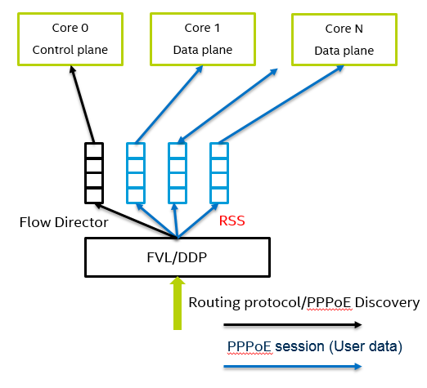
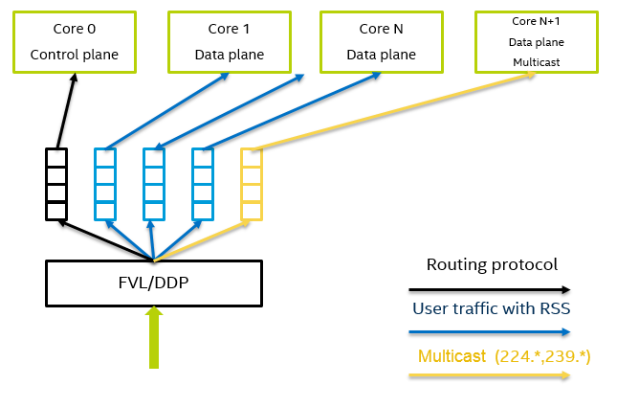
Distribute traffic on NIC
Upstream Traffic
Downstream Traffic

Slide 15
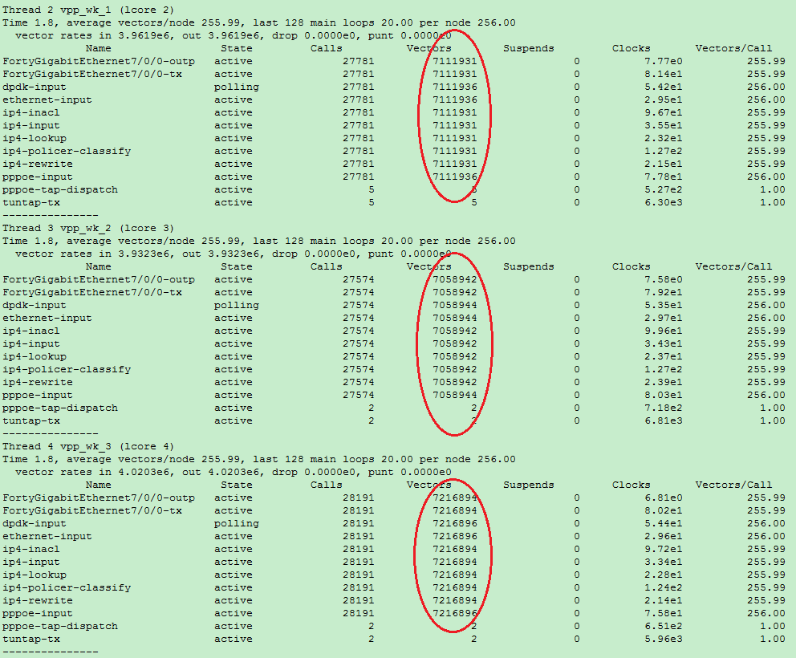
Distrute traffic evenly
Test setup:
64K PPPoE sessions
4 cores for upstream
4 cores for downstream

Slide 16
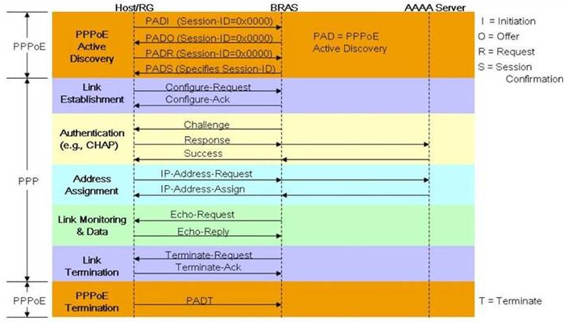
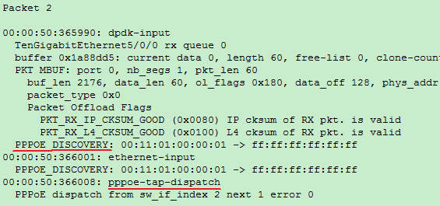
PPPoE Plugin - Discovery and Session Setup
Dispatch packets between client and OpenBRAS.
Learn PPPoE FIB.
Create PPPoE session.
Create downstream route entry automatically.

Slide 17
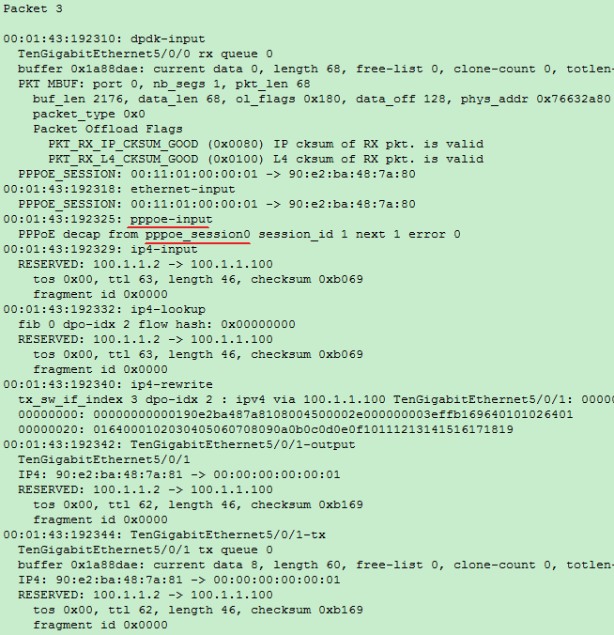
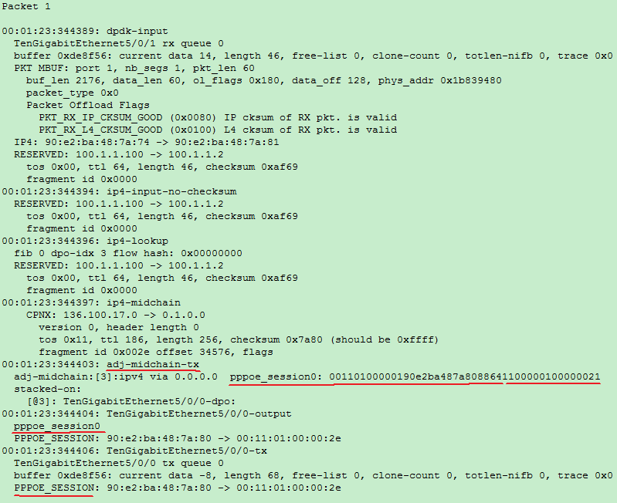
PPPoE Plugin – Upstream and Downstream

Slide 18
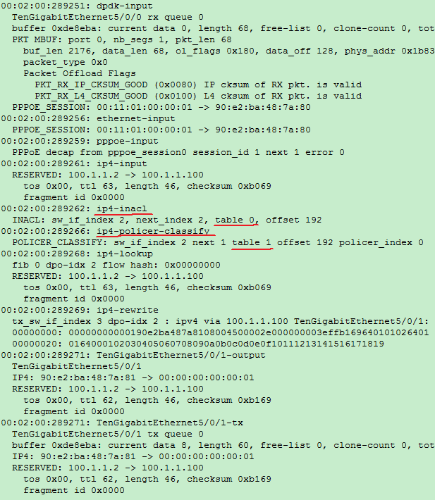
ACL and Policer
ACL:
One ACL rule for each subscriber.
Configurable to match any field.
Policer:
One policer rule for each subscriber.
Configurable to match any field.
Actions: conform/exceed/violate.

Slide 19
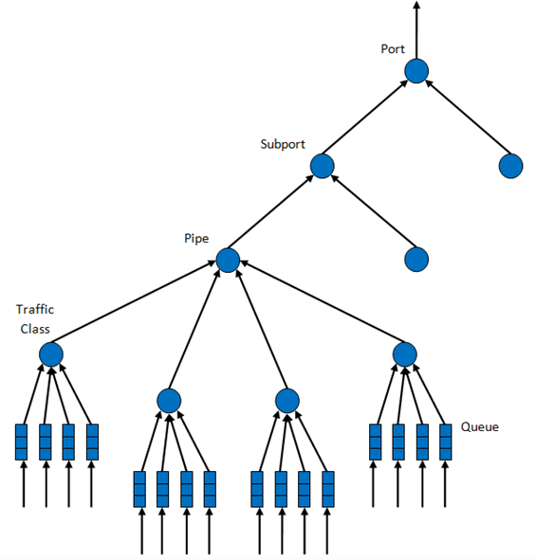
Hierarchical Qos (HQos based on DPDK) added to VPP
Level | Siblings per Parent | Description
Port | . | Output Ethernet port 1/10/40 GbE.
Subport | Configurable (default: 8) | A predefined group of users
Pipe | Configurable (default: 4K) | An individual user/subscriber
Traffic Class (TC) | 4 | A different traffic type with specific loss rate, delay and jitter.
Queue | 4 | Hosts packets from multiple connection of the same type belonging to the same user

Slide 20

Key Takeaway
http://fd.io/
A solution with separated Control Plane and Data Plane.
Implementation ready for Cloud Edge deployment.
Control Plane leverages OpenBRAS, an open source project.
Data Plane leverages VPP and DPDK.
Distribute traffic from NIC to multiple cores evenly.

